Slide 1

Introduction to Web scraping and its Future in Big Data
By Evelyn Delph

Slide 2
Agenda
Web Scraping and Big Data
How to Web Scrape (IMDB Example)
Documentation download
Parsing
Extraction
Transformation
Web Scraping Trends

Slide 3
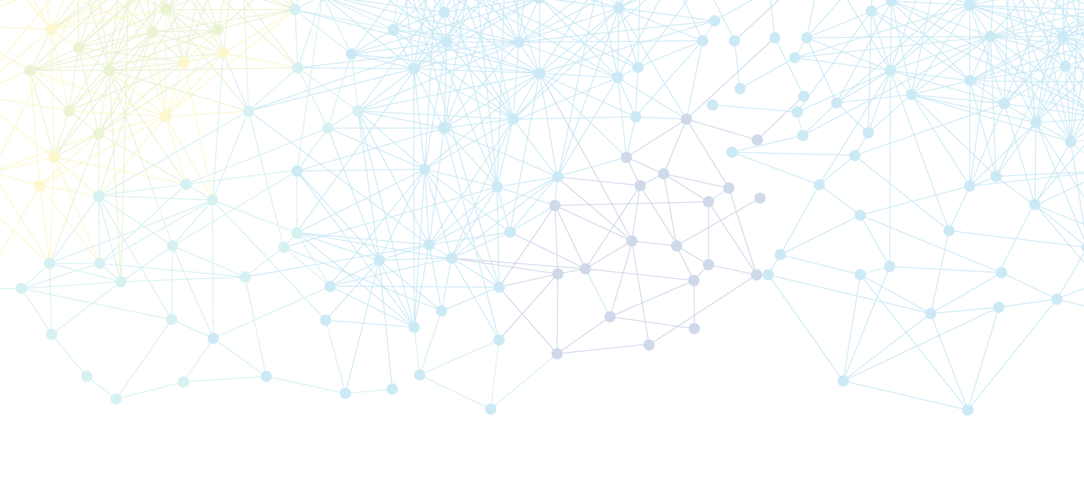
Big Data and Web Scraping Revolution
Big Data Fast Facts
More data was created in the past two years than the entire previous human race
Every second new data is created on the internet
Data is growing faster than ever before.

Slide 4
Basic Steps For Web Scraping
Documentation Load
Parsing
Extraction
Transformation
Load the entire HTML page
Interpret Document
Extract relevant data from loaded HTML document
Convert extracted data into useful formats for decision making

Slide 5


Library/Module Imports
Documentation Load
Parsing
Extraction
Transformation
Documentation Load Code
Urllib
This library provides a high-level interface for fetching data online
The module urllib.request fetches URLs over a simple interface
Urlopen is a specific function that fetches URLs and compatible with a variety of protocols
Open Url
Read in URL
Close out of URL

Slide 6
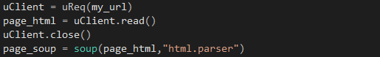
Library/Module Imports
Documentation Load
Parsing
Extraction
Transformation
Parsing Code
Bs4
Bs4 or BeautifulSoup4 is a Python library for pulling data out of HTML or XML Files
Put HTML page into the “soup” function
Save HTML page to a variable
Identify how you want to parse the HTML page

Slide 7
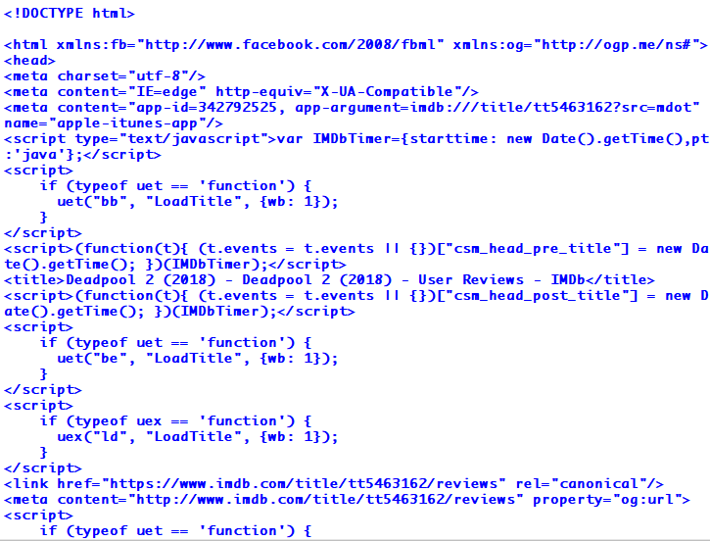
HTML Page After Parsing
Documentation Load
Parsing
Extraction
Transformation

Slide 8
Data Extraction

Slide 9
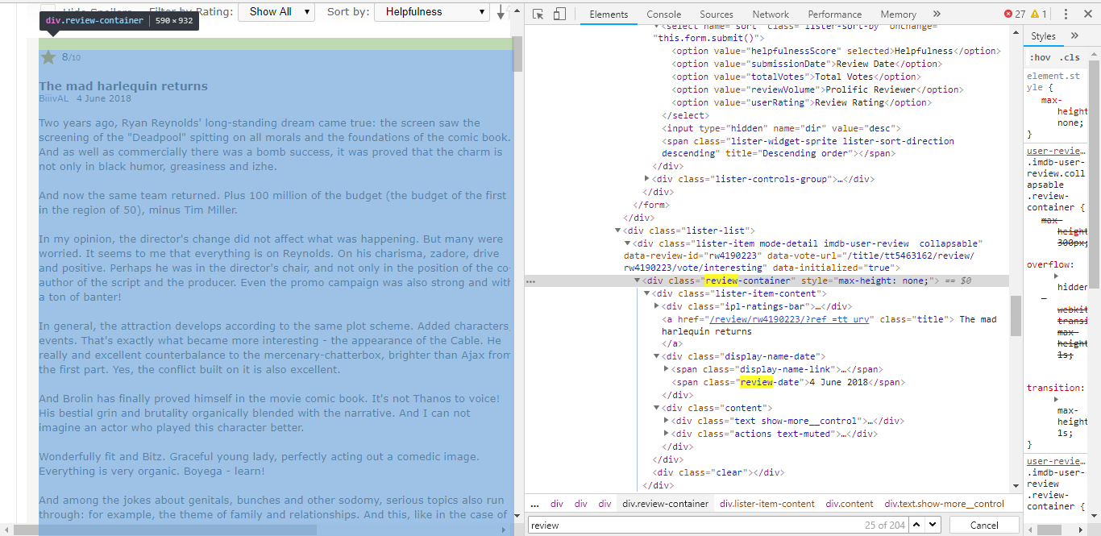
Inspect HTML Page with Dev Tools

Slide 10
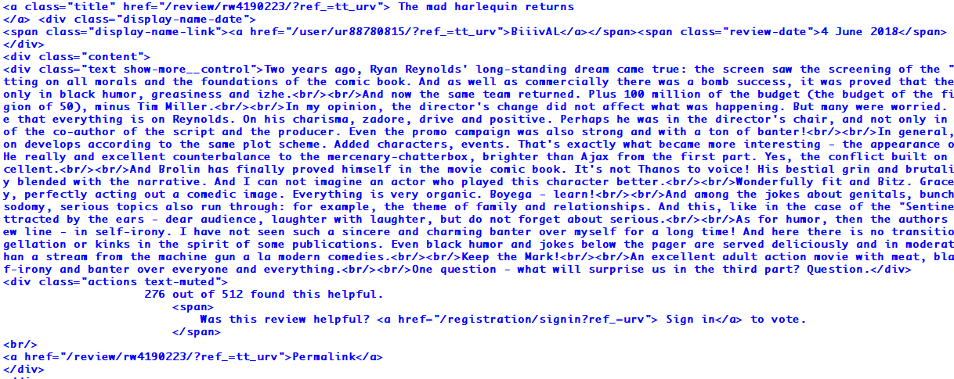
Get All Review Containers
Documentation Load
Parsing
Extraction
Transformation

Slide 11
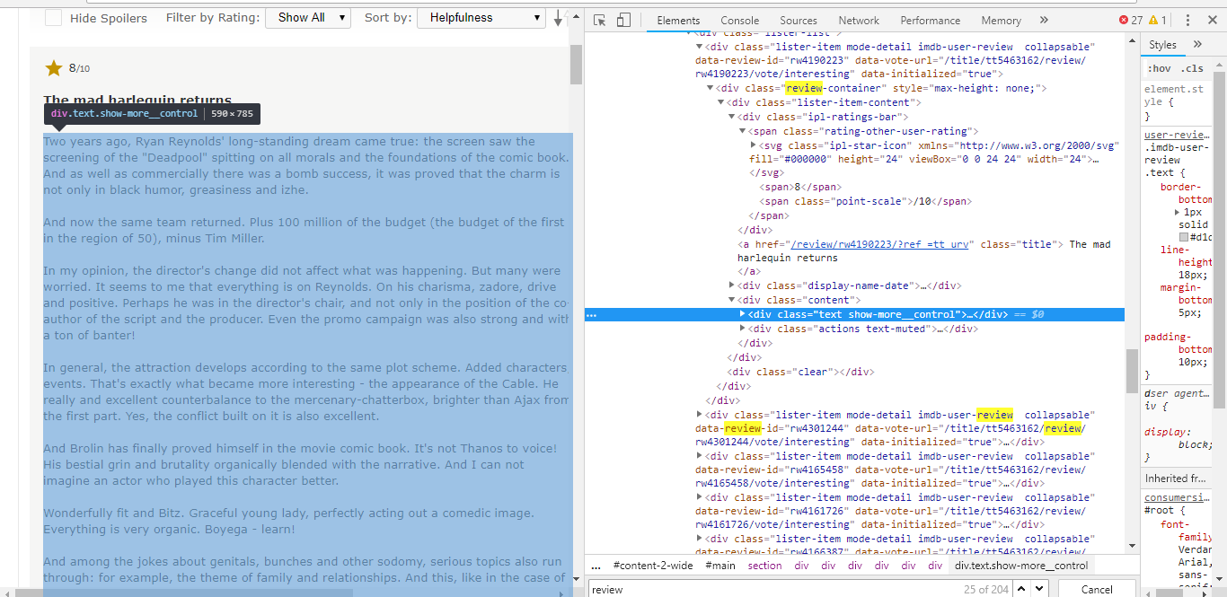
Find the “Reviews” with class=“text show-more__control”

Slide 12
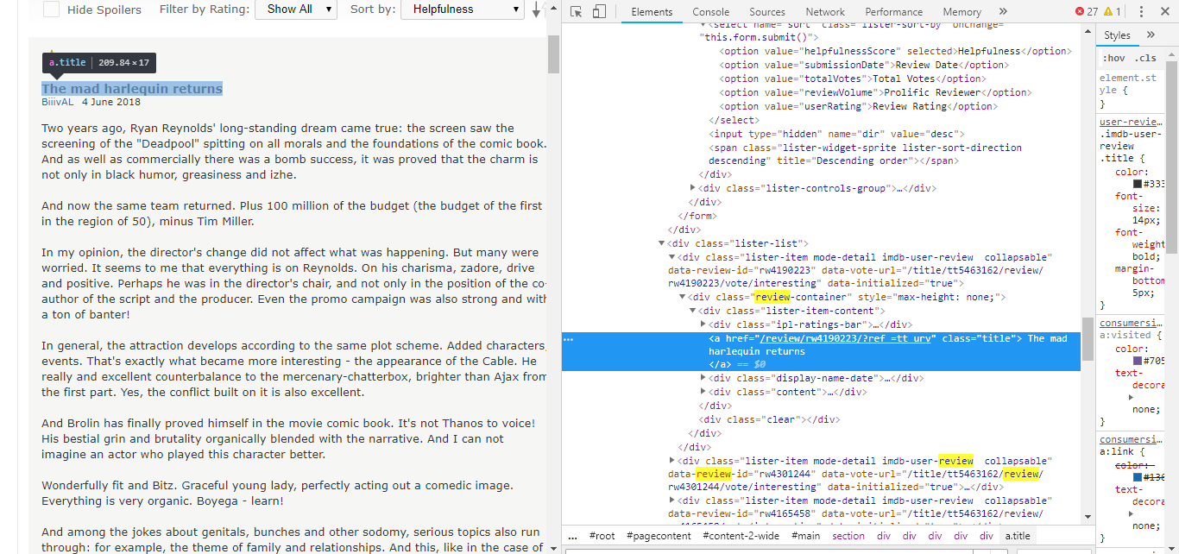
Find the “Titles” with class=“title”

Slide 13
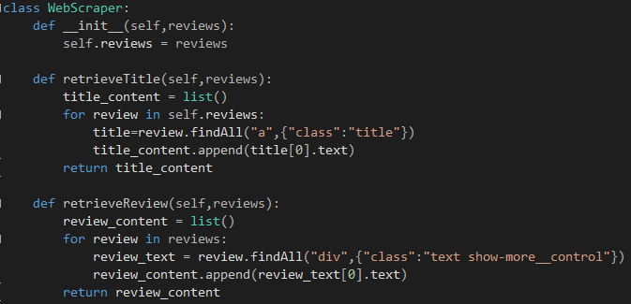
Get The Titles and Reviews
Documentation Load
Parsing
Extraction
Transformation

Slide 14
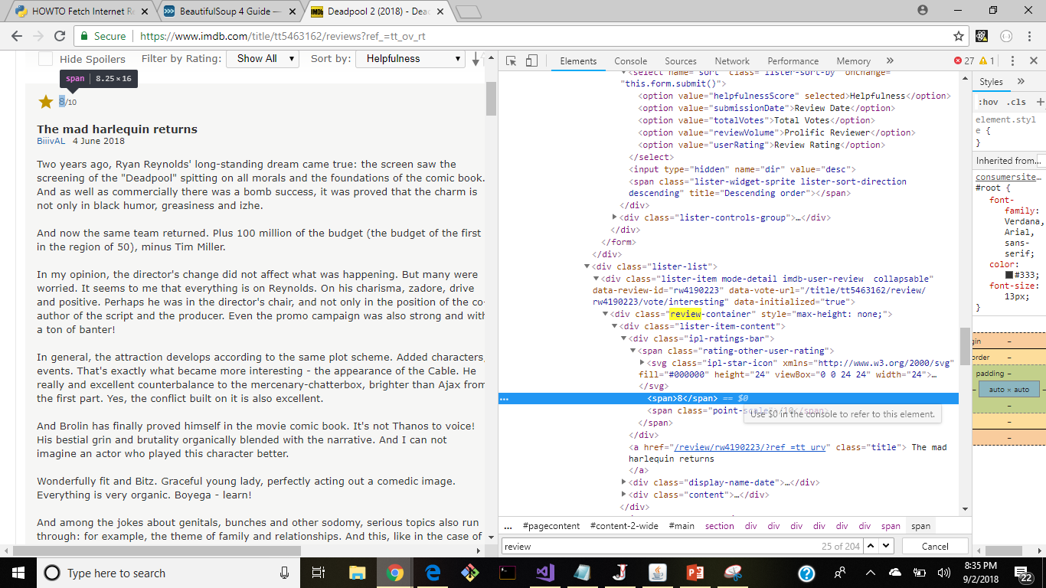
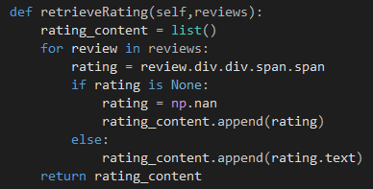
Find the “Ratings” in a Span Tag
Documentation Load
Parsing
Extraction
Transformation

Slide 15
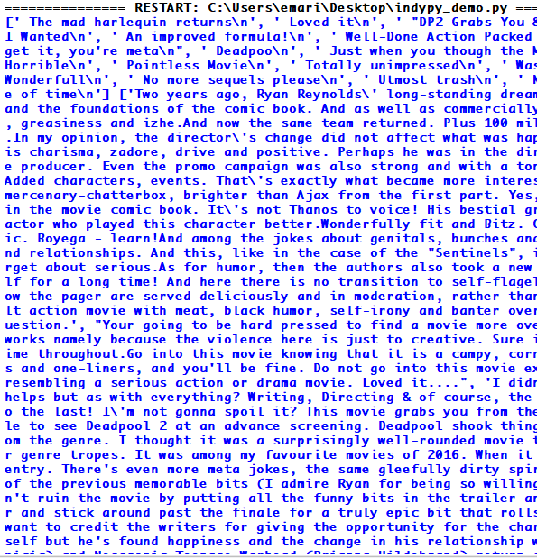
Final Data Extraction
Documentation Load
Parsing
Extraction
Transformation
Now the data is ready for transformation!

Slide 16
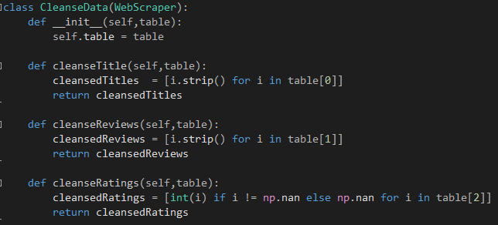
Documentation Load
Parsing
Extraction
Transformation
Cleanse Extracted Data

Slide 17
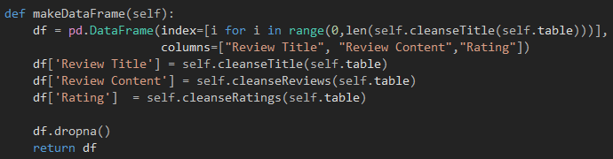
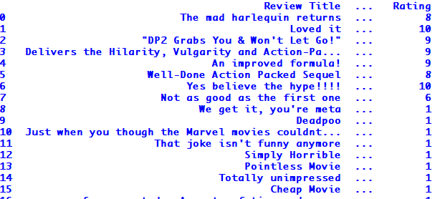
Convert Data into Data Frame
Documentation Load
Parsing
Extraction
Transformation
Converted Data Frame

Slide 18
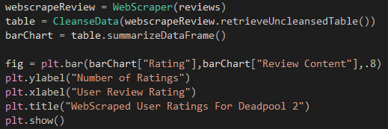
From Data Frame to Graph
Documentation Load
Parsing
Extraction
Transformation
Using Matplotlib.pyplot Module

Slide 19
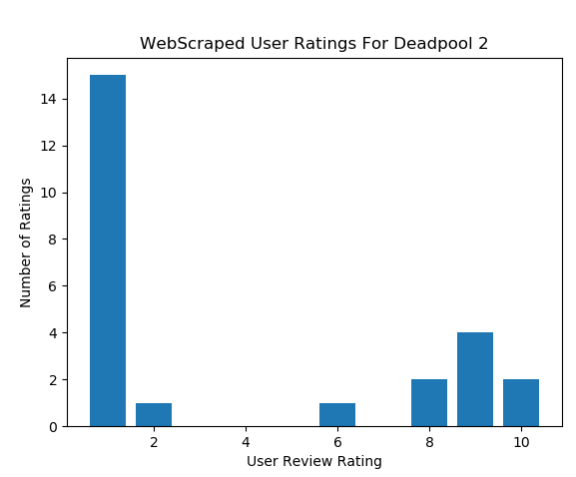
From Data Frame to Graph
Documentation Load
Parsing
Extraction
Transformation

Slide 20
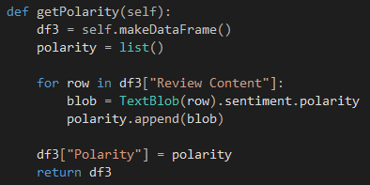
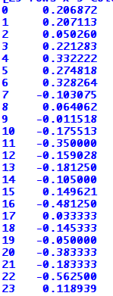
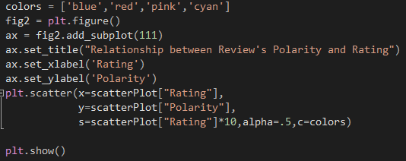
More Analysis With Data Frames
Documentation Load
Parsing
Extraction
Transformation

Slide 21
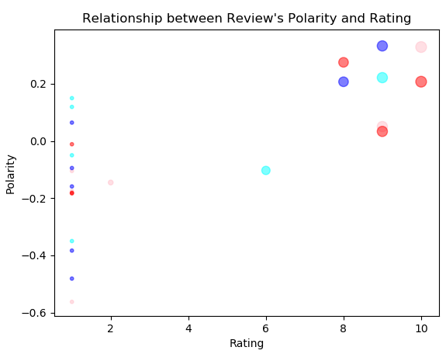
More Analysis With Data Frames
Documentation Load
Parsing
Extraction
Transformation

Slide 22
Basic Steps For Web Scraping
Documentation Load
Parsing
Extraction
Transformation
Load the entire HTML page
Interpret Document
Extract relevant data from loaded HTML document
Convert extracted data into useful formats for decision making

Slide 23
Future of Web Scraping
Scrape product details. 2. Scrape property details and agent contact details from real estate websites 3. Scrape contact details of businesses as well as individuals from yellow pages websites 4. Scrape people profiles from social networks like Facebook, LinkedIn etc. for tracking online reputation. 5. Scrape hospital/clinic websites to build a catalog of health physicians including their contact details 6. Scrape reviews of products and places/hotels/restaurants 7. Crawl forums and communities to extract data from posts and authors 8. Scrape articles from various article/PR websites to feature in own website 9. Scrape data from various Government websites, most of which do not provide an easy way to download the data which they display.

Slide 24
Thank you!

